Slide 1

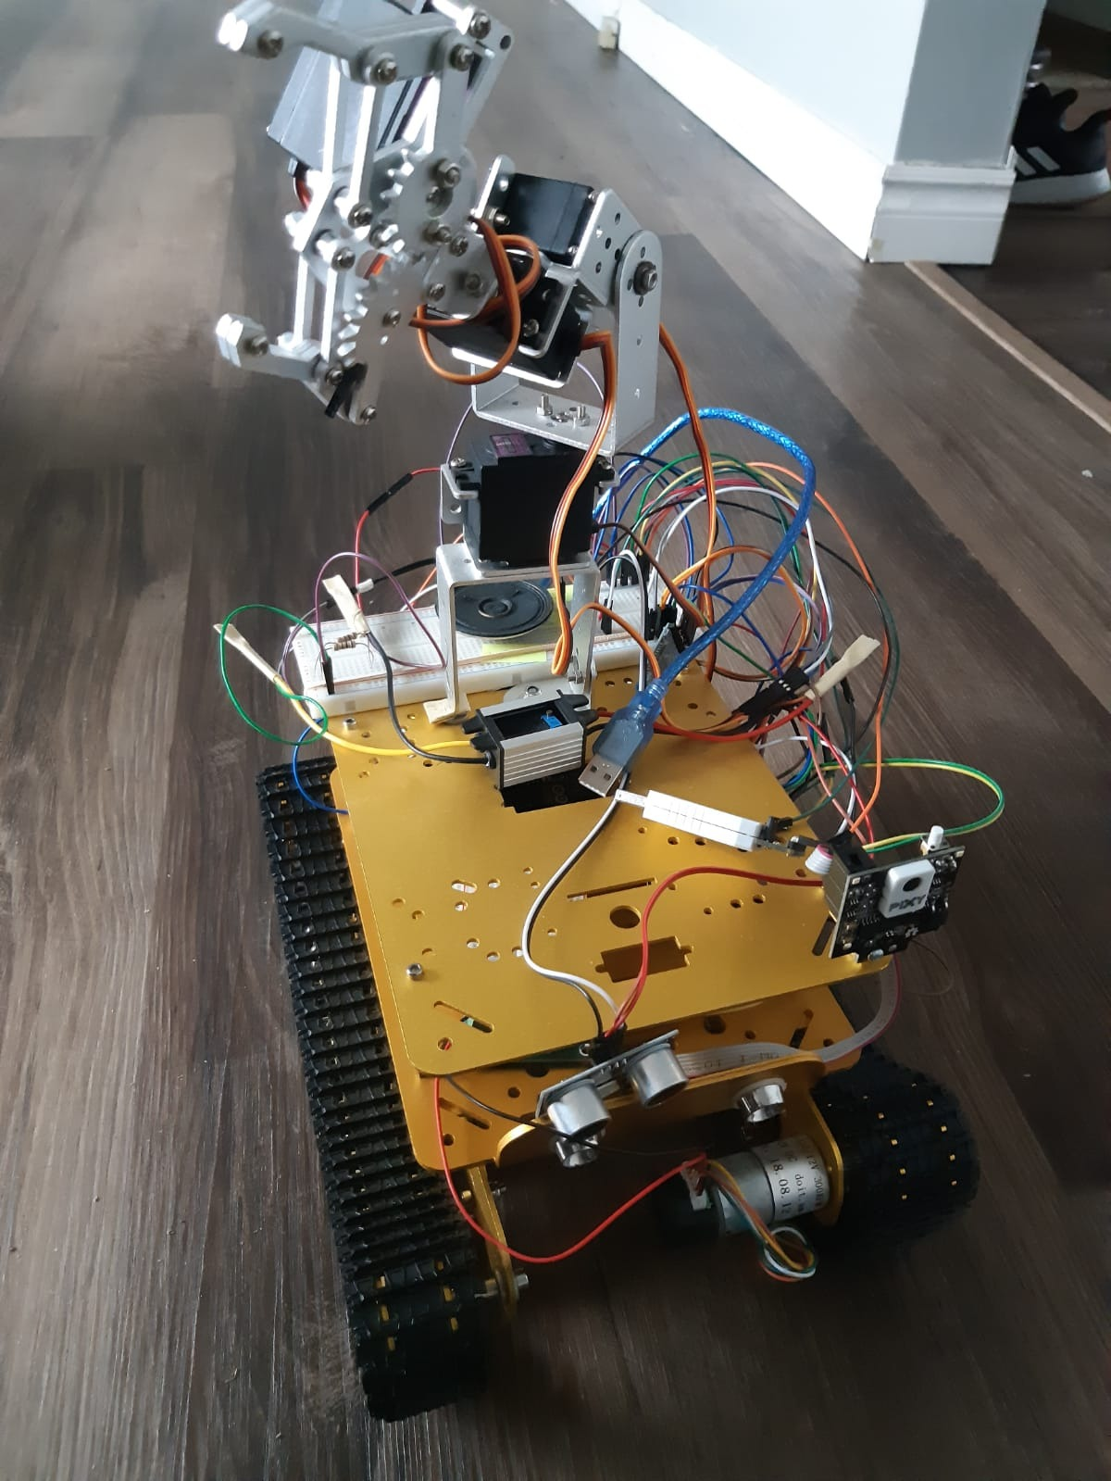
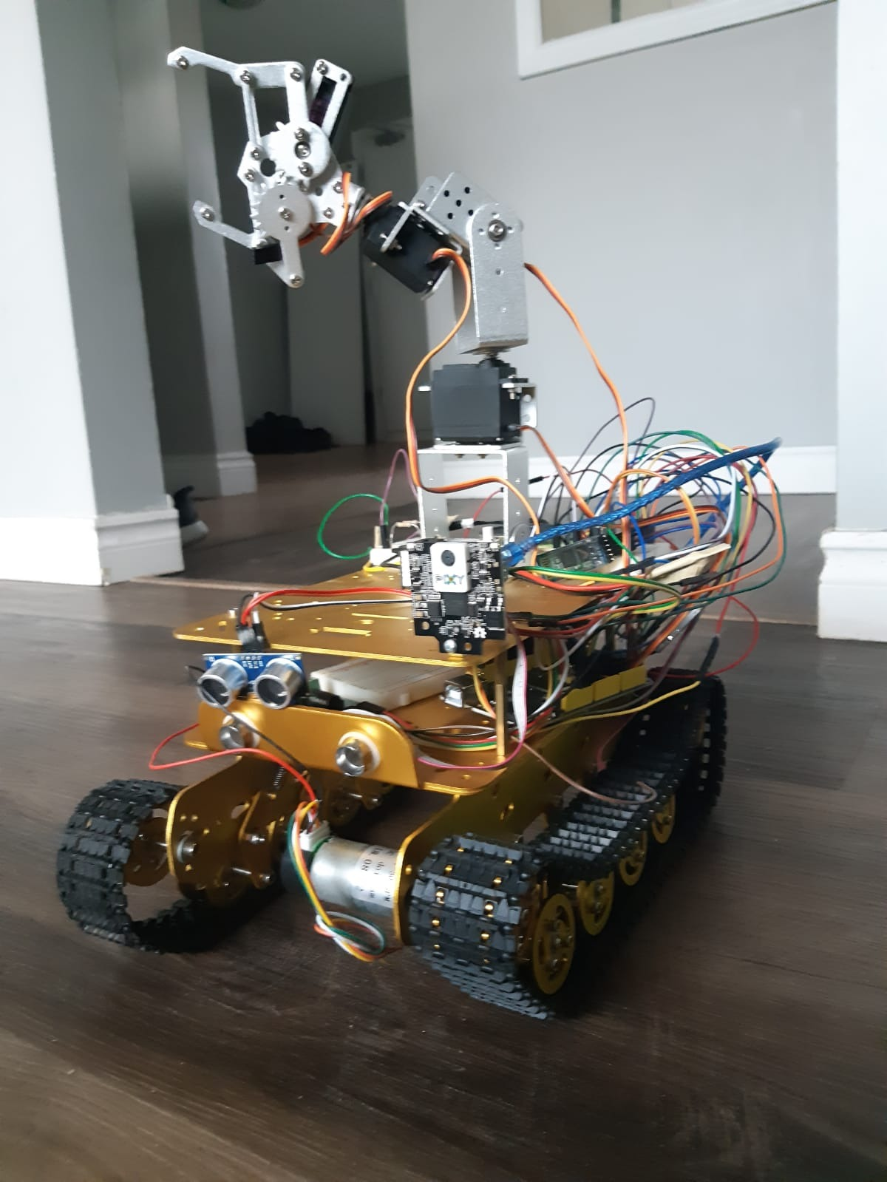

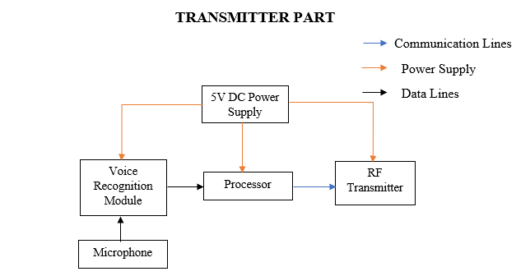
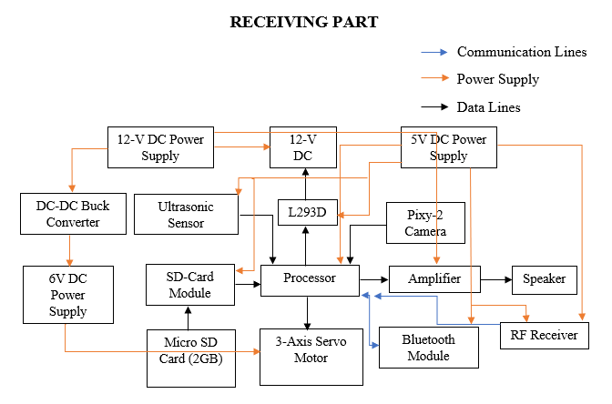
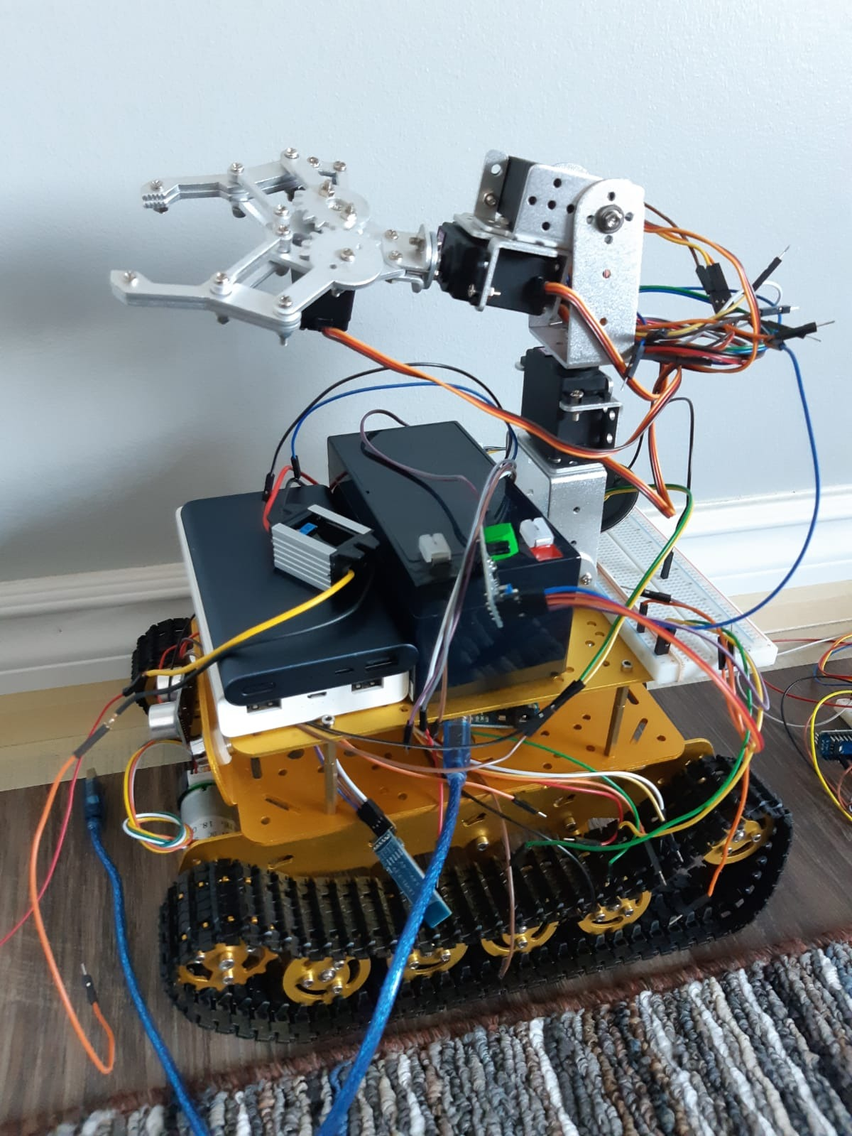
PERSONAL ASSISTANT ROVER
(CHITTI)
^{EMBEDDED SYSTEM DEVELOPMENT}
ABSTRACT
FEATURES OF CHITTI
CONCLUSIONS
We are going to build a Personal Assistant Rover which will grab the object from the predefined location and bring back to the user. There will be three Arduino boards used, one is Arduino Mega, Arduino Uno and Arduino Nano. The Mega will be connected to the rover and the Uno is used to send the signals for the motors, arm and the speech commands wirelessly to the rover. People like physically challenged, bedridden can take advantage of this rover. Also, it would be helpful for the factory people for some daily routine work.
I can move – it has the DC motor to move front, back, left and right.
I can lift – it has got a servo motor installed 4 axis arm for lifting an object.
I can see – it has got a camera to make the autonomous operation work and avoid obstacles.
I can hear – it has got microphone to listen to the user’s instructions.
I can speak – it has a speaker installed to give pre stored voice commands to the users.
Our main goal was to make a rover to solve the real world problems economically.
We came up with two modes to make things happen, both the modes are working fine independently.
When we combined both the modes with switching control, it did not go well as expected.
FUTURE SCOPE
Since there were power issues when interfacing the camera, this part should given more time in future.
The circuit can be designed in PCB.
RESULTS
A clear idea of the concept that fits to the real world problems have been developed.
Collection of components have been done as planned.
Separate software patches have been created for testing every single components.
We interfaced the components accordingly.
We went through lot of troubles through out the process and fixed the same after gathering necessary information.
We achieved decent results and created a solution for operating the rover in manual mode and autonomous mode.
We faced a power consumption issue on switching the modes.
DETAILED INFORMATION
CONTACT INFORMATION
Santhosh Nagendran
santhoshguptha95@gmail.com
+14379812425
Kunalsinh Gohil
kgohil3202@conestogac.on.ca
+12263393735
Sankeerth Reddy Dargula
sdargula4702@conestogac.on.ca
+12265052301
ACKNOWLEDGEMENT
We express our gratefulness to Mr. Michael Jarabek, Professor and Program Co-ordinator, Embedded System Development for providing us kind advice during the development of the project.
Our hearty thanks to our guide Mr. Allan Smith, Professor, Embedded Systems Development, Conestoga College, for his constant support and guidance offered to us during the course of our project by being one among us.

